Slide 1
INFO 323:Cloud Computing and Big Data
College of Computing and Informatics
Drexel University
Introduction to Hadoop, Big Data Processing Pipelines, and Spark
Yuan An, PhD
Associate Professor

Slide 2
Open Source Platforms for Big Data
BigQuery is Google managed proprietary service.
Apache Hadoop and Spark are open source platforms for big data processing.
Anyone can build on-premises Hadoop clusters running Spark programs.

Slide 3
Apache Hadoop

Slide 4
Apache Hadoop
The Apache Hadoop project develops open-source software for reliable, scalable, distributed computing.
A framework that allows for the distributed processing of large data sets across clusters of computers using simple programming models.
Designed to scale up from single servers to thousands of machines.
Designed to detect and handle failures at the application layer rather than rely on hardware to deliver high-availability.

Slide 5
Hadoop
A data storage and processing software ecosystem.
Initially based on a central concept: data locality.
Data locality refers to the pattern of processing data where it resides by bringing the computation to the data.
Using a shared nothing approach.
Was created by Yahoo! In 2005

Slide 6
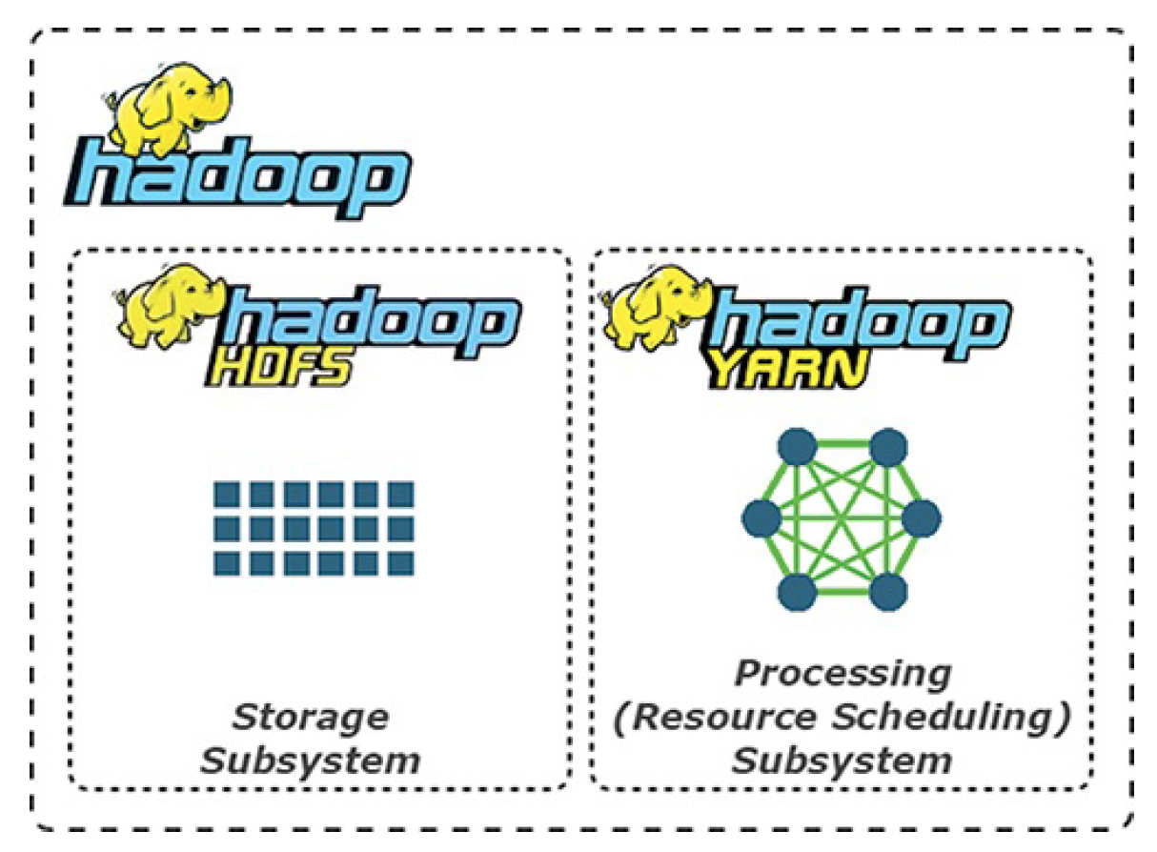
Hadoop Core Components

Slide 7













Hadoop Ecosystem
Higher levels:
Interactivity
Hive
Pig
Giraph
Storm
Spark
Flink
MapReduce
YARN
HDFS
HBase
Zookeeper
Cassandra
MongoDB
Lower levels: Storage
Scheduling

Slide 8
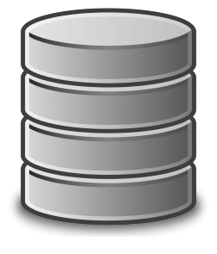













Distributed File System as Foundation
Scalable storage
Fault tolerance
Hive
Pig
Giraph
Storm
Spark
Flink
MapReduce
YARN
HDFS
HBase
Zookeeper
Cassandra
MongoDB

Slide 9



Flexible Scheduling and Resource Management
YARN schedules jobs on
> 40,000 servers at Yahoo
Pig
Hive
Giraph
Storm
Spark
Flink
MapReduce
YARN
HDFS
HBase
Zookeeper
Cassandra
MongoDB

Slide 10
Simplified Programming Model
Map → apply()
Reduce → summarize()
Hive
Pig
Giraph
Storm
Spark
Flink
MapReduce
HBase
Zookeeper
Cassandra
MongoDB
Yarn
HDFS

Slide 11

Higher-level Programming Models
Pig = dataflow scripting
Hive = SQL-like queries
Hive
Pig
Giraph
Storm
Spark
Flink
MapReduce
HBase
Cassandra
Zookeeper
Pig created at Yahoo,
MongoDB
YARN
Hive created at Facebook
HDFS

Slide 12
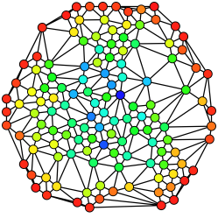

Specialized Models for graph Processing
Giraph used by Facebook
to analyze social graphs
Hive
Pig
Giraph
Storm
Spark
Flink
MapReduce
YARN
HDFS
HBase
Zookeeper
Cassandra
MongoDB

Slide 13

Real-time and In-Memory Processing
In-memory → 100x faster for some tasks
Hive
Pig
Giraph
Storm
Spark
Flink
MapReduce
YARN
HDFS
HBase
Zookeeper
Cassandra
MongoDB

Slide 14
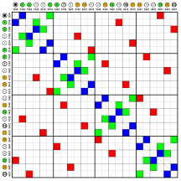
NoSQL for Unstructured Files
Key-values
Sparse tables
Hive
Pig
Giraph
Storm
Spark
Flink
MapReduce
HBase u_{Y}s_{AR}e_{N}d for Facebook’s
Messaging Platform
HBase
Zookeeper
Cassandra
MongoDB
HDFS

Slide 15
Zookeeper for Management
Synchronization
Configuration
High-availability
Hive Pig
Giraph
Storm
Spark
Flink
MapRedule
HBase
Zookeeper
Cassandra
MongoDB
Yarn
HDFS

Slide 16

Growing Number of Open Source Tools
Large community for support
Pre-built images
Cloudera
Hortonworks
Hive
Pig
Giraph
Storm
Spark
Flink
MapReduce
YARN
HDFS
HBase
Zookeeper
Cassandra
MongoDB

Slide 17
Agenda
Big data processing pipelines
Shortcomings of Hadoop MapReduce
Apache Spark

Slide 18
Prepare to Run Spark
Create a google dataproc cluster and link it to a storage bucket
Upload data files to the notebooks/jupypter folder under the google storage bucket: (They are in Week 4 on the Course shell)
words.txt
2015-summary.csv, 2015-summary.json
mnm-dataset.csv
Upload notebook files to the notebooks/jupyter folder under the google storage bucket:
INFO323-Lecture-week4-Spark-1-Intro-Spark-Programming.ipynb
INFO323-Lecture-week4-Spark-2-testSpark.ipynb
INFO323-Lecture-week4-Spark-3-counting-MnM.ipynb
Open the notebooks under the Web Interfaces

Slide 19
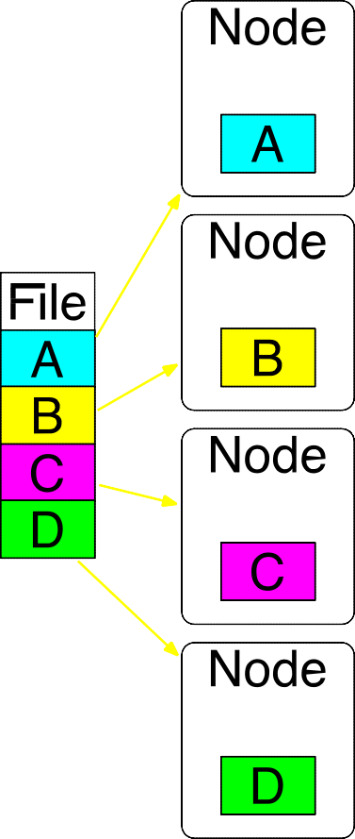
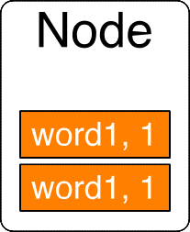
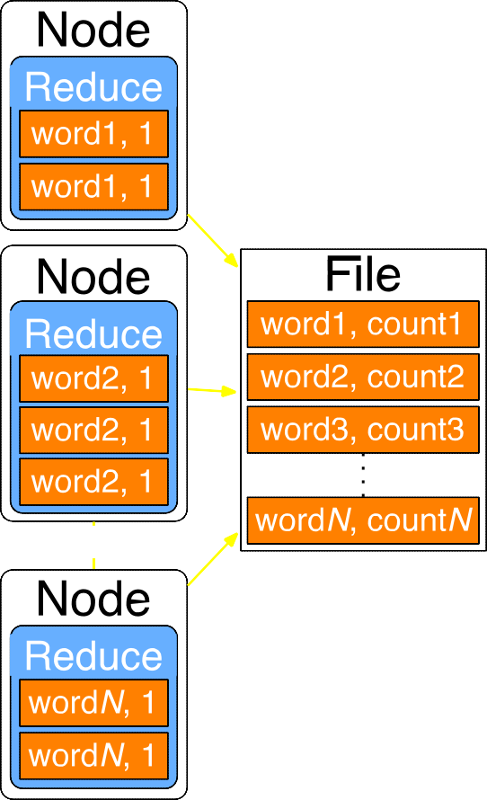
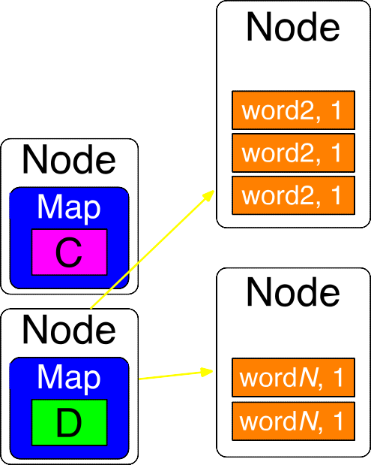
Big Data Processing Pipeline
Step 1: Split
Step 3: Shuffle and Sort
Step 4: Reduce
Step 2: Map

Slide 20
Transformations in Big Data Processing
When data flows through pipelines, transformations are applied.
Transformations are tools to shape the data.
Common data transformations:
Map
Reduce
Group
Join ….

Slide 21
Hadoop for Big Data Processing
Higher levels:
Interactivity
Coordination and workflow management
Hive
Pig
Giraph
Storm
Spark
Flink
Data integration and processing
MapReduce
YARN
HDFS
HBase
Zookeeper
Cassandra
MongoDB
Data Management and storage
Lower levels: Storage
Scheduling

Slide 22
Hadoop is Cumbersome
Hadoop MR was hard to manage and administer, with cumbersome operational complexity.
Intermediate computed results are written to the local disk for the subsequent stage of its operation.
Lots of software systems in its ecosystem: Apache Hive, Apache Storm, Apache Impala, Apache Giraph, Apache Drill, Apache Mahout, etc.
Each with their own APIs and cluster configurations, further adding to the operational complexity of Hadoop and the steep learning curve for developers.

Slide 23
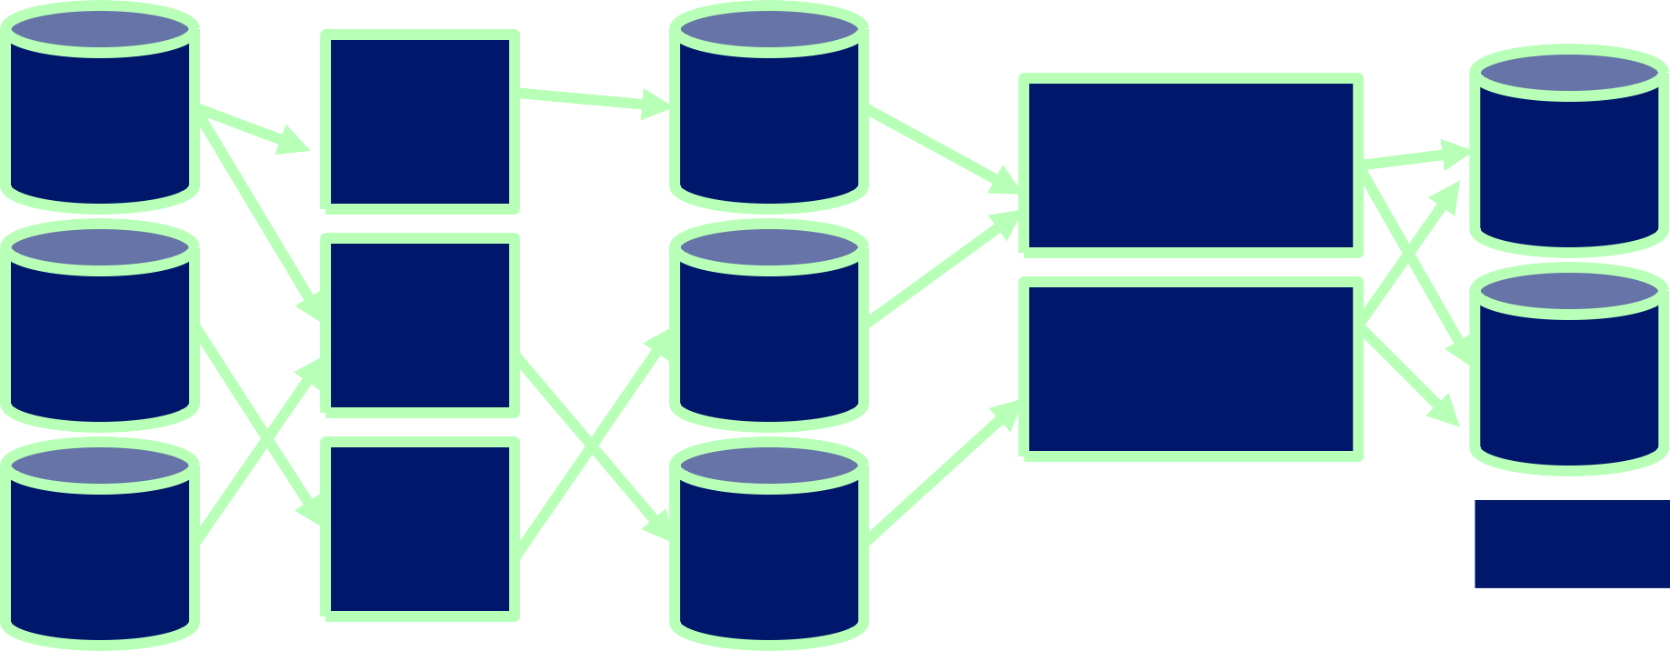
Hadoop MapReduce Processing
MAP
REDUCE
MAP
REDUCE
MAP
HDFS
HDFS
Disk

Slide 24
MapReduce
Execution Model
Batch processing using disk storage
Latency
High-latency
Scalability
Programming Language
Java Replication
Fault Tolerance

Slide 25
Shortcomings of Hadoop MapReduce
Only for Map and Reduce based computations
Relies on reading data from HDFS
Native support for Java only
No interactive shell support
No support for streaming

Slide 26

De-facto standard unified analytics engine for big data processing
Largest open-source project in data processing
Technology created by the founders of Databricks
Notes:
Unified analytics engine for big data processing, with built-in modules for streaming, SQL, machine learning and graph processing
The de-facto standard unified analytics engine
Is the largest open-source project in data processing
Was created by the founders of Databricks

Slide 27
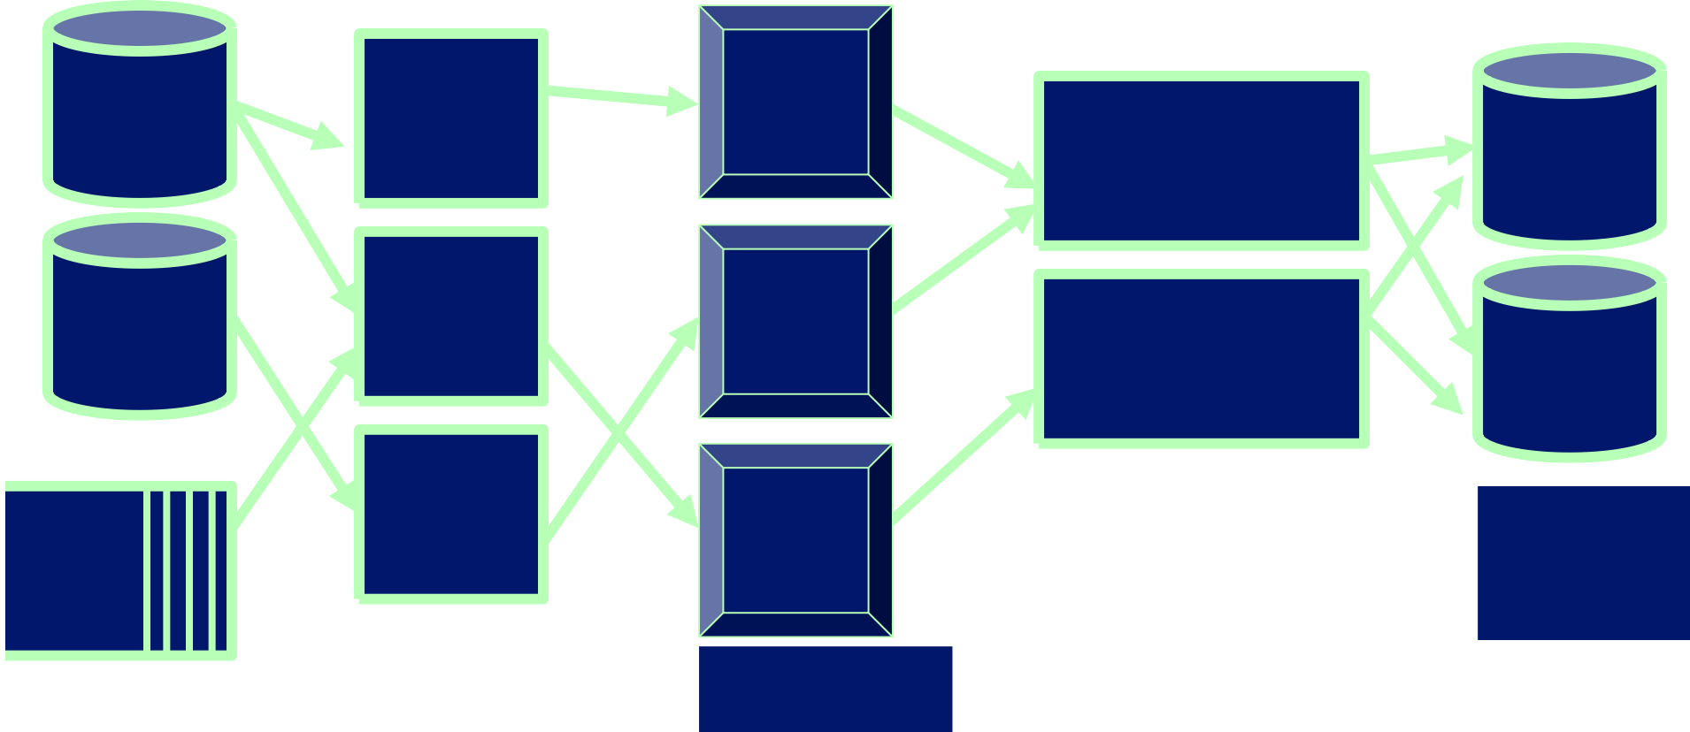
Apache Spark In-Memory Processing
Resilient Distributed Datasets
HDFS
Transformation
Transformation
NoSQL
Store
Transformation
Transformation
Transformation
Data Stores
…
Stream
Memory

Slide 28
Apache Spark
Batch and stream processing using disk or memory storage
Low-latency for small micro-batch size
Execution Model
Latency
Scalability
Programming Language
Scala, Python, Java, R
Fault Tolerance

Slide 29
Features of Spark
Spark implements a distributed, fault-tolerant, in-memory structure called a Resilient Distributed Dataset (RDD).
Spark maximizes the use of memory across multiple machines, significantly improving overall performance.
Spark’s reuse of these in-memory structures makes it well suited to iterative machine learning operations as well as interactive queries.

Slide 30
Programming Interfaces to Spark
Spark provides native support for programming interfaces including the following:
Scala
Python (using Python’s functional programming operators)
Java
SQL
R

Slide 31
Why Spark?
Expressive programming model
In-memory processing
Support for diverse workloads
Interactive shell

Slide 32
Spark Background
An open source distributed data processing project started in 2009 by Matei Zaharia at the University of California, Berkeley, RAD Lab.
As part of the Mesos research project, designed to look at an alternative resource scheduling and orchestration system to MapReduce.
Became an alternative to using traditional MapReduce on Hadoop.

Slide 33



Spark Benefits
Fast
Easy to Use
Unified
Notes:
100x faster than Hadoop for large scale data processing
Easy-to-use APIs for operating on large datasets
A unified API and engine for SQL queries, streaming data, machine learning. Spark can be seamlessly combined with other tools to create complex workflows
---
Speed
100x faster than Hadoop for large scale data processing
Easy to use
Spark has easy-to-use APIs for operating on large datasets
It is a “unified” analytics engine
This means that it comes packaged with libraries including support for SQL queries, streaming data, machine learning, and graph processing.
This leads to an increase in developer productivity
This means that Spark can be seamlessly combined with other tools to create complex workflows

Slide 34
Use of Spark
Extract-transform-load (ETL) operations
Predictive analytics and machine learning
Data access operations, such as SQL queries and visualizations
Text mining and text processing
Real-time event processing
Graph applications
Pattern recognition
Recommendation engines

Slide 35
Spark API
Spark SQL + DataFrames
Streaming
MLib
Spark Core API
R
SQL
Python
Scala
Java
Notes:
Here’s a quick overview of the core modules available in Spark.
Spark SQL+DataFrames
Many data scientists, analysts, and general business intelligence users rely on interactive SQL queries for exploring data. Spark SQL is a Spark module for structured data processing. It provides a programming abstraction called DataFrames and can also act as a distributed SQL query engine. It enables unmodified Hadoop Hive queries to run up to 100x faster on existing deployments and data. It also provides powerful integration with the rest of the Spark ecosystem (e.g., integrating SQL query processing with machine learning).
Spark streaming
Many applications need the ability to process and analyze not only batch data but also streams of new data in real-time. Running on top of Spark, Spark Streaming enables powerful interactive and analytical applications across both streaming and historical data, while inheriting Spark’s ease of use and fault tolerance characteristics. It readily integrates with a wide variety of popular data sources, including HDFS, Flume, Kafka, and Twitter.
MLib for machine learning
Machine learning has quickly emerged as a critical piece in mining Big Data for actionable insights. Built on top of Spark, MLlib is a scalable machine learning library that delivers both high-quality algorithms (e.g., multiple iterations to increase accuracy) and blazing speed (up to 100x faster than MapReduce). The library is usable in Java, Scala, and Python as part of Spark applications, so that you can include it in complete workflows.
Spark Core API
Spark Core is the underlying general execution engine for the Spark platform that all other functionality is built on top of. It provides in-memory computing capabilities to deliver speed, a generalized execution model to support a wide variety of applications, and Java, Scala, and Python APIs for ease of development.

Slide 36
Submission Types to Spark Programs
Spark programs can run interactively or as batch jobs, including mini-batch and micro-batch jobs.

Slide 37
Input and Output Types
Although Spark is mostly used to process data in Hadoop, Spark can be used with a multitude of other source and target systems, including the following:
Local or network filesystems
Object storage such as Amazon S3 or Ceph
Relational database systems
NoSQL stores, including Cassandra, HBase, and others
Messaging systems such as Kafka

Slide 38
Spark RDD
The primary data abstraction structure for Spark applications, is one of the main differentiators between Spark and other cluster computing frameworks.
In-memory collections of data distributed across a cluster.
Spark programs using the Spark core API consist of
loading input data into an RDD
transforming the RDD into subsequent RDDs
storing or presenting the final output for an application from the resulting final RDD.

Slide 39
Spark DataFrame
A DataFrame is the most common Structured API and simply represents a table of data with rows and columns.
The list that defines the columns and the types within those columns is called the schema.
A spreadsheet sits on one computer in one specific location, whereas a Spark DataFrame can span thousands of computers.
The reason for putting the data on more than one computer should be intuitive:
either the data is too large to fit on one machine or
it would simply take too long to perform that computation on one machine.

Slide 40
Spark Hadoop
Spark can read and write data to HDFS
YARN could be a platform for managing Spark applications
Spark can read and write to a variety of file systems
Spark can use other platforms for managing applications

Slide 41
Spark Execution
Job
Task 1
Spark application
Stage 1
Job
Task 2
Stage 2
Job
Notes:
Spark uses clusters of machines to process big data by breaking a large task into smaller ones and distributing the work among several machines.
Let’s look at how spark executes a spark application.
Jobs
The secret to Spark’s performances is parallelism. Each parallelized action is referred to as a job. Each job is broken down into stages.
Stages
Each job is broken down into stages, which is a set of ordered steps that, together, accomplish a job.
Tasks
Tasks are created by the driver and assigned a partition of data to process. These are the smallest unit of work.

Slide 42
Spark Cluster
Driver
Worker
Worker
Worker
Worker
Executor
Executor
Executor
Executor
Core
Task
Core
Task
Core
Task
Core
Core
Core
Core
Task
Core
Task
Notes:
Let’s go over each of the items in the diagram below to identify the components that Spark uses to coordinate work across a cluster of computers.
Driver
The driver is the machine in which the application runs. It is responsible for three main things
maintaining information about the Spark Application
responding to the user's program
analyzing, distributing, and scheduling work across the executors.
In a single Databricks cluster, there will only be one driver, regardless of the number of executors.
Worker node
A worker node hosts the Executor process. It has a fixed number of Executors allocated at any point in time.
Executors
Each executor will hold a chunk of the data to be processed. This chunk if called a Spark partition. It is a collection of rows that sits on one physical machine in the cluster.
Note: This is completely separate from hard disk partitions, which have to do with the storage space on a hard drive.
Executors are responsible for carrying out the work assigned by the driver. Each executor is responsible for two things:
Execute code assigned by the driver
Report the state of the computation back to the driver
Cores (also known as slots or threads)
Spark parallelizes at two levels. One is splitting the work among executors. The other is the slot. Each executor has a number of slots. Each slot can be assigned a task.
In this diagram, some slots have been filled by task and some slots are open.
We’ll dive deeper in Spark architecture and execution in day 4 of our class. But for now, we just need to understand these concepts at a high level.
---
While the abstractions and interfaces are simple, managing clusters of computers and ensuring production-level stability is not. Databricks makes big data simple by providing Apache Spark as a hosted solution, where much of your Spark setup will be managed for you. However, understanding basic Spark architecture and execution concepts is essential to Spark development, as you will see later in the course.

Slide 43
Deploy Spark
There are several common deployment modes for Spark, including the following:
Local mode
Spark Standalone
Spark on YARN (Hadoop)
Spark on Mesos

Slide 44
Local Mode (Recommendation for Quick Tests)
Local mode allows all Spark processes to run on a single machine, optionally
using any number of cores on the local system.
A quick way to test a new Spark installation
allows you to quickly test Spark routines against small datasets.

Slide 45
Cloud-based Spark
Dataproc in GCP
Databricks Community Edition:
https://community.cloud.databricks.com
Free single node cluster
Fast test Spark applications

Slide 46
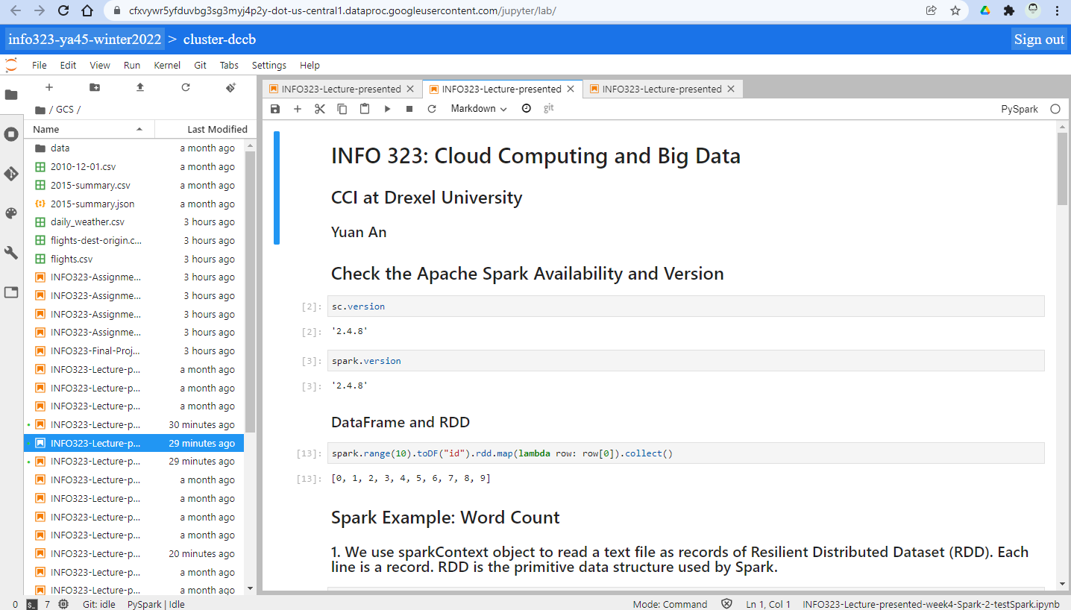
Run Jupyter Notebooks on Dataproc Cluster

